Slide 1
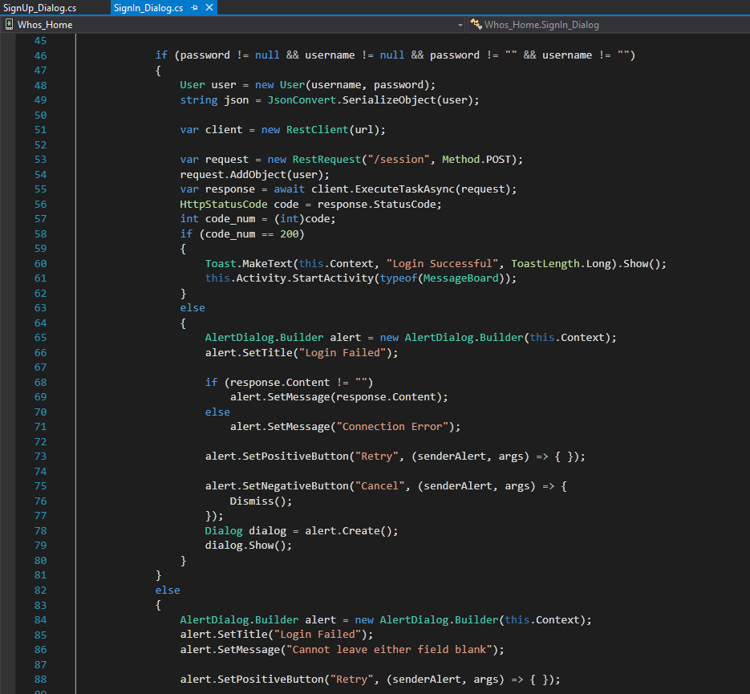
Sign In
Request
Grabs text from all fields
Add text to a user object
Translate it into a JSON formatted string
Send in POST request
Response
Read Status Code
Display errors if any

Slide 2
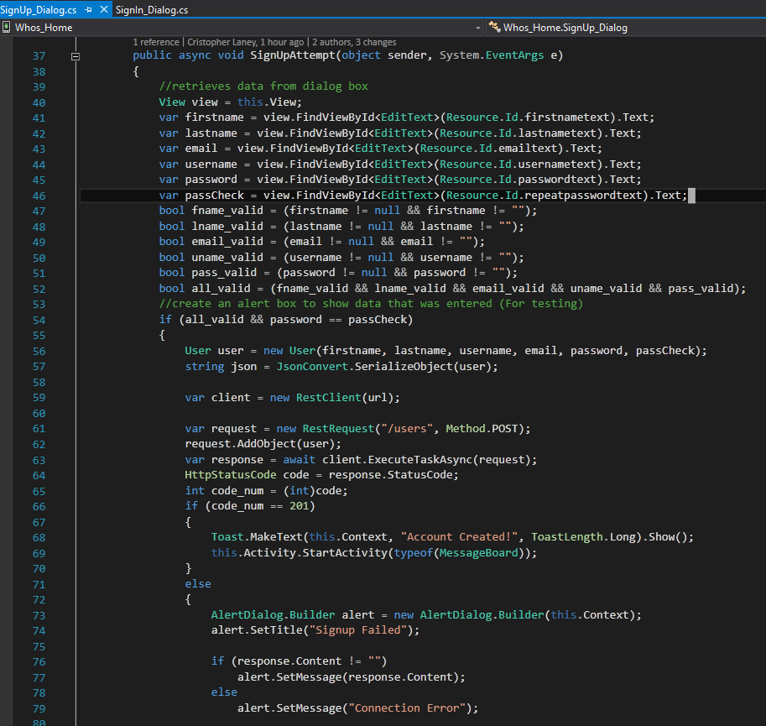
Sign Up
Request
Similar to Sign In, but many more fields
Some simple input validation
Response
Recieves response and displays any necessary information

Slide 3
Devops (A necessary evil)
Server Issues
Git Issues
Xamarin Issues
Database Rebuilds

